Slide 1

The Spill-Proof Ice Cream Cone
A cleaner and smarter way to enjoy ice cream
Presented by B Shalini

Slide 2
What This Product Is
A Special Design
Mess-Free Enjoyment
This is a unique ice cream cone featuring an innovative, wide wafer base.
It’s specifically designed to catch drips, ensuring hands remain clean and sticky-free.
Fully Edible
Every part of this cone, including the drip-catcher, is 100% edible, leaving no waste.

Slide 3





The Problem With Normal Cones
Melting Mess
Ice cream quickly melts, leading to drips everywhere.
Sticky Hands
The inevitable consequence of drips, making the experience unpleasant.
Accidental Drops
Especially for children, cones can be easily dropped due to slipperiness.
Excessive Waste
The need for extra tissues or paper napkins creates unnecessary waste.

Slide 4
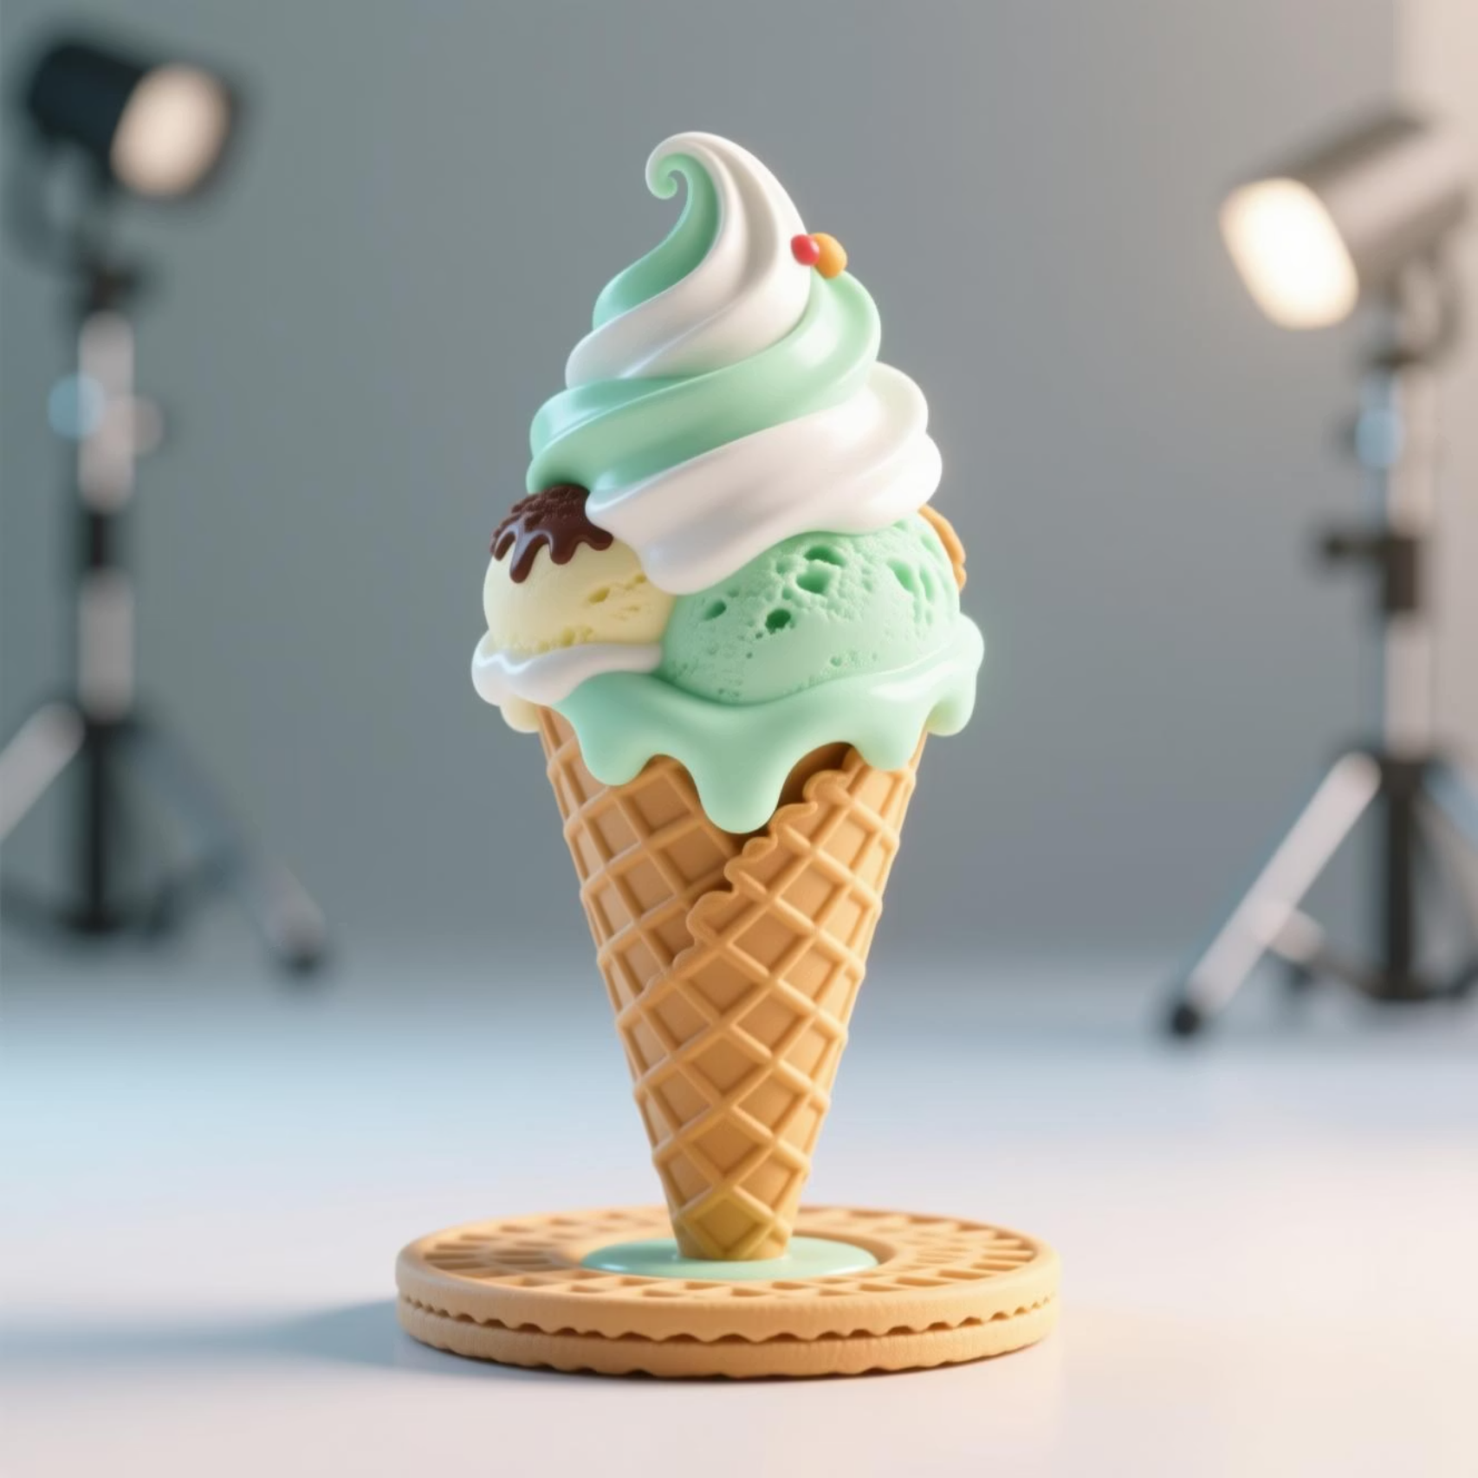
Our Simple Solution
1
2
3
4
1
Built-in "Plate"
A cone with a smart, integrated wafer base at the bottom.
2
Catches Every Drip
Designed to capture all melting ice cream, preventing any mess.
3
Easy to Handle
Comfortable to hold, making it ideal for everyone, especially children.
4
No Mess, No Waste
Enjoy your treat without any fuss or environmental impact.

Slide 5





Key Features
Drip-Proof Design
Crunchy Wafer Base
100% Edible
Engineered to prevent any melted ice cream from dripping.
An additional textured wafer base that adds to the enjoyment.
From cone to base, every part is safe and delicious to eat.
Enhanced Stability
Fun and Unique Look
More stable than traditional cones, reducing accidental drops.
A distinctive design that stands out and is visually appealing.

Slide 6

Why It’s Better
Normal Cone
Messy
Unstable
Sticky
The Spill-Proof Cone
Clean
Easy to hold
Zero drip

Slide 7



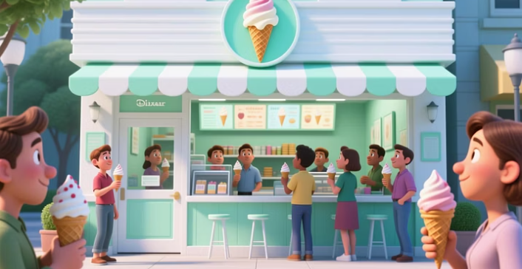

Who Will Love It
1
Ice Cream Shops
2
Beaches & Parks
3
Families & Kids
4
Cafés & Dessert Stalls
5
Events & Parties

Slide 8
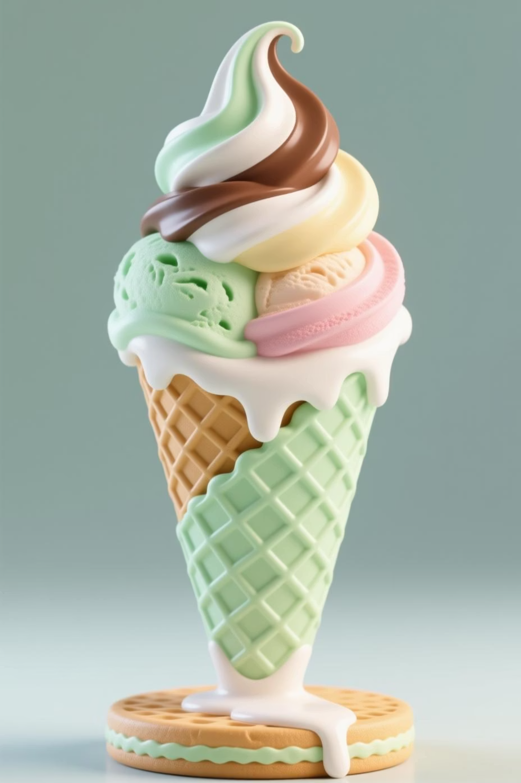
Benefits for Businesses
01
Happier Customers
Enhanced enjoyment leads to greater customer satisfaction and loyalty.
02
Reduced Costs
Less need for napkins and cleaning supplies, lowering operational expenses.
03
Unique Selling Point
Differentiate your offering with an innovative and practical product.
04
Social Media Appeal
Highly shareable and photogenic, boosting your online presence and brand visibility.

Slide 9
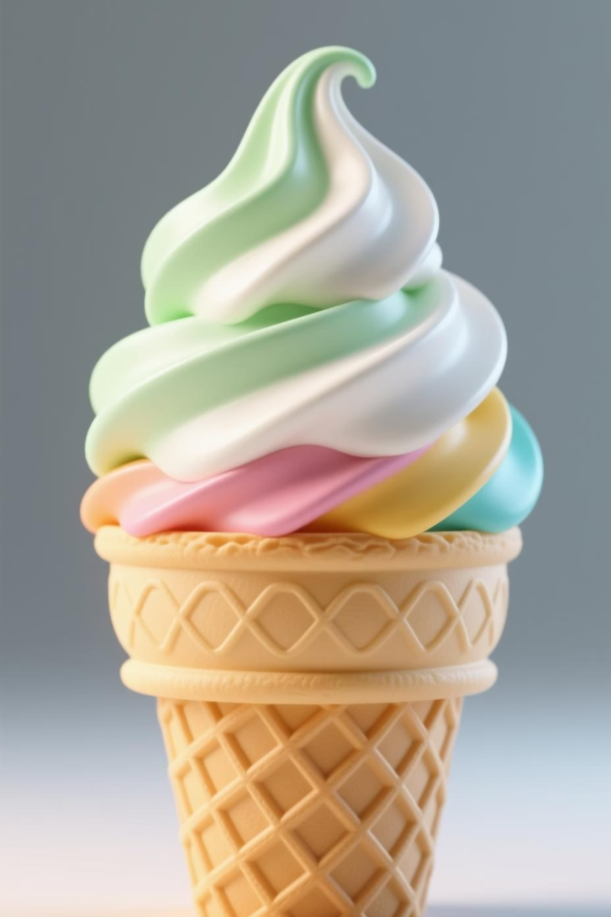
Final Message
A cleaner way to enjoy ice cream – it's simple, smart, and tasty!

Slide 10



Call to Action
Experience the future of ice cream enjoyment today.

